Slide 1


Introduction
Name: Vivek Pawar
Div: A & Roll No.: 70
Vocational Training Presentation
On
Full Stack Development

Slide 2
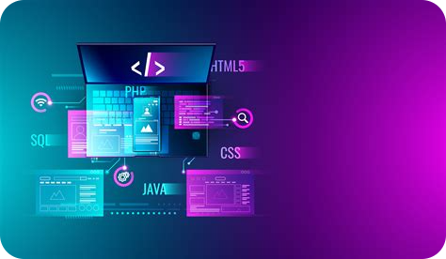
Vocational Training Presentation on Full Stack Development
This presentation provides an overview of Vivek Bandu Pawar 15-day industrial training in full stack development with Fourise Software Solution Pvt Ltd. It covers the industrial overview, trainer description, training objectives, internship activities, and projects completed during the training.

Slide 3
Industrial Overview
Training Details
I have completed a 15-day industrial training in full stack development with Fourise Software Solution Pvt Ltd under the guidance of Sudhir Patil and Mrs. Santoshi Pallaye. During this training, he learned about industry operations and gained practical experience in web development, including HTML, CSS, JavaScript.

Slide 4


Trainer Description
Trainer Qualifications
Mr. Sudhir Patil, the trainer, has 2.5+ years of industrial experience. He has worked on MERN stack websites and as a full stack developer, handling US projects.

Slide 5
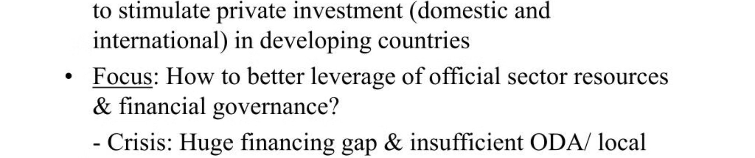
Training Objectives
Key Objectives
The objectives of the training were to provide industrial knowledge, understand the situation of companies, learn how to handle work within time, develop teamwork and management skills, gain practical knowledge, and enhance technical skills.

Slide 6

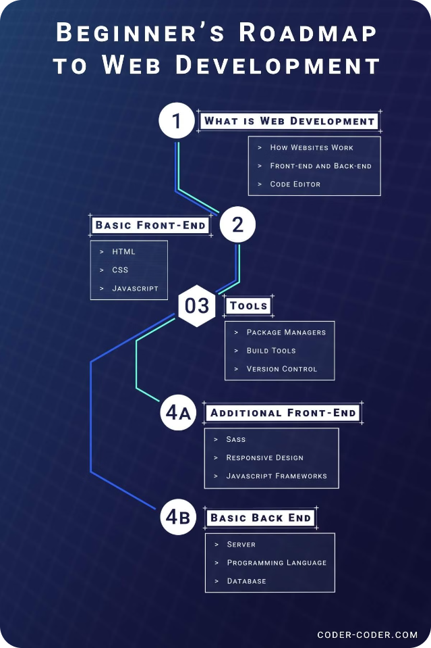
Internship Activities
Activities Covered
During the internship, I gained experience in full stack development, developed basic websites, focused on frontend development, connected frontend to backend services, and deepened my skills .

Slide 7

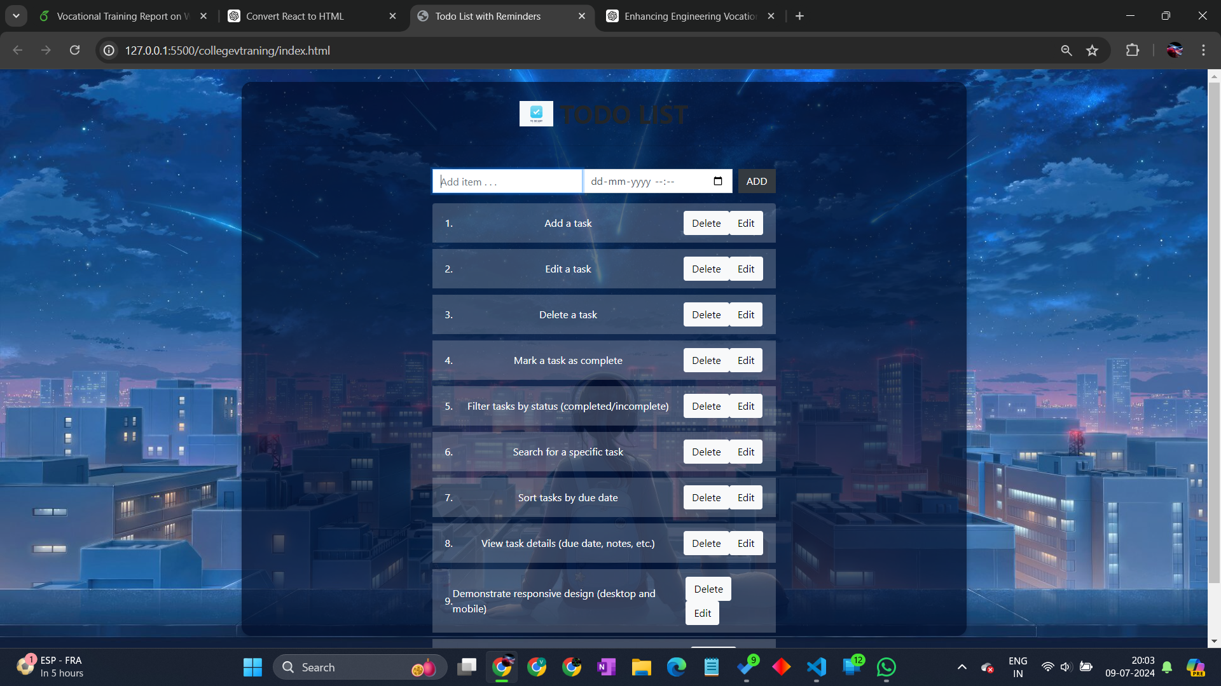
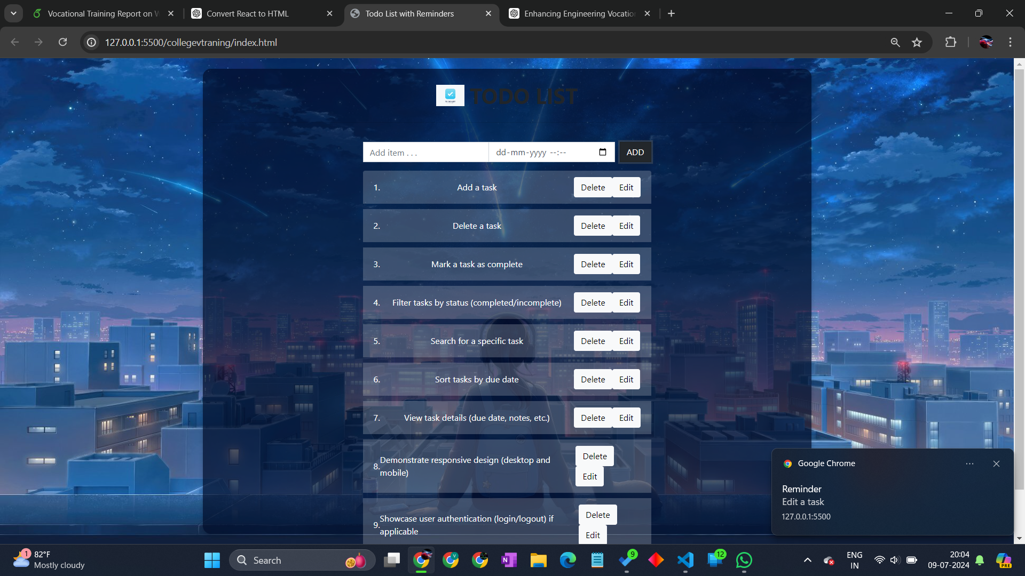
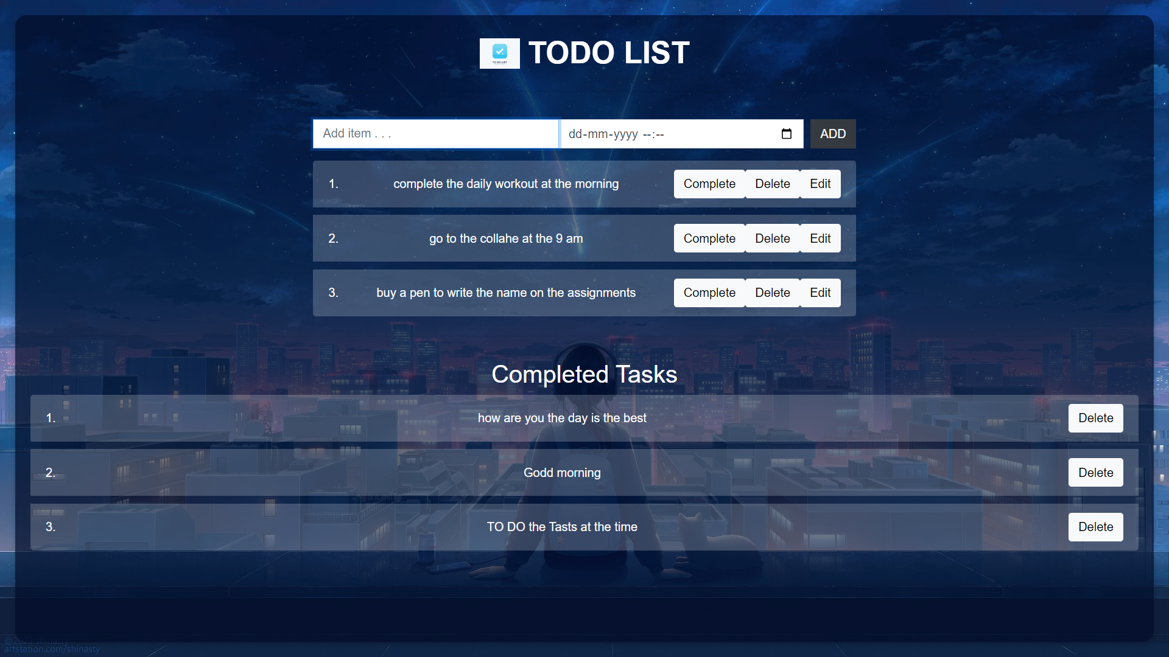
Project
Project Overview
I have worked on a project during his internship, In which I designed A TO DO LIST website using HTML,CSS,JS in which all the things contain in website is fetched dynamically.

Slide 8


Conclusion
Knowledge Gained
I learned how to design a full-stack website and work with the HTML,CSS & JS.

Slide 9

Thank You
I expresses my gratitude for the opportunity to complete this vocational training.

